Slide 1
Luke 14:1-24
(English Standard Version)
4 Slides

Slide 2
14 One Sabbath, when he went to dine at the house of a ruler of the Pharisees, they were watching him carefully. ² And behold, there was a man before him who had dropsy. ³ And Jesus responded to the lawyers and Pharisees, saying, “Is it lawful to heal on the Sabbath, or not?” ⁴ But they remained silent. Then he took him and healed him and sent him away. ⁵ And he said to them, “Which of you, having a son or an ox that has fallen into a well on a Sabbath day, will not immediately pull him out?” ⁶ And they could not reply to these things.

Slide 3
⁷ Now he told a parable to those who were invited, when he noticed how they chose the places of honour, saying to them, ⁸ “When you are invited by someone to a wedding feast, do not sit down in a place of honour, lest someone more distinguished than you be invited by him, ⁹ and he who invited you both will come and say to you, ‘Give your place to this person,’ and then you will begin with shame to take the lowest place. ¹⁰ But when you are invited, go and sit in the lowest place, so that when your host comes he may say to you, ‘Friend, move up higher.’ Then you will be honoured in the presence of all who sit at table with you. ¹¹ For everyone who exalts himself will be humbled, and he who humbles himself will be exalted.”

Slide 4
¹² He said also to the man who had invited him, “When you give a dinner or a banquet, do not invite your friends or your brothers or your relatives or rich neighbours, lest they also invite you in return and you be repaid. ¹³ But when you give a feast, invite the poor, the crippled, the lame, the blind, ¹⁴ and you will be blessed, because they cannot repay you. For you will be repaid at the resurrection of the just.”
¹⁵ When one of those who reclined at table with him heard these things, he said to him, “Blessed is everyone who will eat bread in the kingdom of God!” ¹⁶ But he said to him, “A man once gave a great banquet and invited many. ¹⁷ And at the time for the banquet he sent his servant to say to those who had been invited, ‘Come, for everything is now ready.’

Slide 5
¹⁸ But they all alike began to make excuses. The first said to him, ‘I have bought a field, and I must go out and see it. Please have me excused.’ ¹⁹ And another said, ‘I have bought five yoke of oxen, and I go to examine them. Please have me excused.’ ²⁰ And another said, ‘I have married a wife, and therefore I cannot come.’ ²¹ So the servant came and reported these things to his master. Then the master of the house became angry and said to his servant, ‘Go out quickly to the streets and lanes of the city, and bring in the poor and crippled and blind and lame.’ ²² And the servant said, ‘Sir, what you commanded has been done, and still there is room.’ ²³ And the master said to the servant, ‘Go out to the highways and hedges and compel people to come in, that my house may be filled. ²⁴ For I tell you, none of those men who were invited shall taste my banquet.’ ”

Slide 6
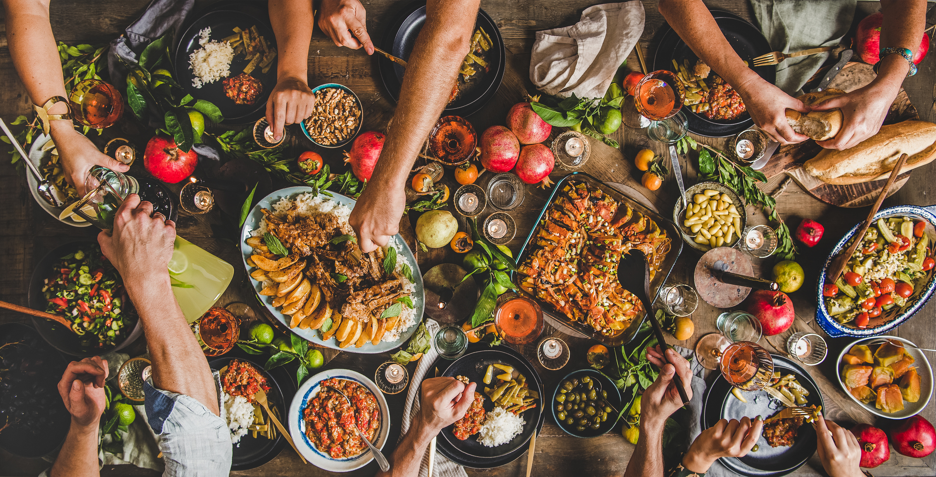
You are invited to the Mega-Banquet. RSVP to the Heavenly Father, today.

Slide 7
1. A Question of Law
The Sabbath is God’s gift – a time for rest, prayer and worship;
Deeds of mercy are acceptable on the Sabbath.
2. A Social Lesson
Don’t claim a place of honour (to rub shoulders with the dignitaries)
Proverbs 25: (ESV)
⁶ Do not put yourself forward in the king’s presence
or stand in the place of the great,
⁷ for it is better to be told, “Come up here,”
than to be put lower in the presence of a noble.…

Slide 8
1. A Question of Law
The Sabbath is God’s gift – a time for rest, prayer and worship;
Deeds of mercy are acceptable on the Sabbath.
2. A Social Lesson
Don’t claim a place of honour (to rub shoulders with the dignitaries)
¹¹ For everyone who exalts himself will be humbled, and he who humbles himself will be exalted.”
The way of Christ: Put others first now; Exalted in the Kingdom of God
3. A Spiritual Lesson
Invite those who can give nothing in return & receive heavenly reward.
Godly, “Just Living” is to generously invite outsiders into our joy and celebration
Invited to the Mega-Banquet – Receive Jesus – No Excuses.
Jesus came for all of Israel (Jews); AND for the Gentiles (non-Jews)
The time to respond to the invitation is NOW
“A man once gave a great banquet and invited many. ¹⁷ And at the time for the banquet he sent his servant to say to those who had been invited, ‘Come, for everything is now ready.’ ¹⁸ But they all alike began to make excuses. The first said to him, ‘I have bought a field, and I must go out and see it. Please have me excused.’ ¹⁹ And another said, ‘I have bought five yoke of oxen, and I go to examine them. Please have me excused.’ ²⁰ And another said, ‘I have married a wife, and therefore I cannot come.’ ²¹ So the servant came and reported these things to his master. Then the master of the house became angry and said to his servant, ‘Go out quickly to the streets and lanes of the city, and bring in the poor and crippled and blind and lame.’ ²² And the servant said, ‘Sir, what you commanded has been done, and still there is room.’ ²³ And the master said to the servant, ‘Go out to the highways and hedges and compel people to come in, that my house may be filled. ²⁴ For I tell you, none of those men who were invited shall taste my banquet.’ ”

